Slide 1
K-MEANS CLUSTERING

Slide 2
INTRODUCTION-
What is clustering?
Clustering is the classification of objects into different groups, or more precisely, the partitioning of a data set into subsets (clusters), so that the data in each subset (ideally) share some common trait - often according to some defined distance measure.

Slide 3
K-MEANS CLUSTERING
The k-means algorithm is an algorithm to cluster n objects based on attributes into k partitions, where k < n.

Slide 4
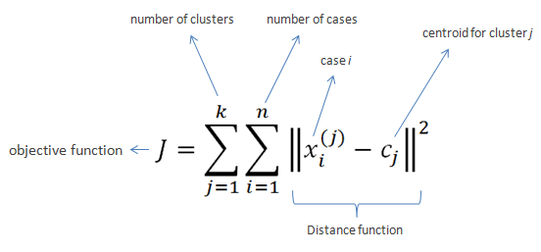
K-MEANS CLUSTERING
An algorithm for partitioning (or clustering) N data points into K disjoint subsets S_{j} (k clusters) containing data points so as to minimize the sum-of-squares criterion
where x_{i} is a vector representing the the n^{th} data point and c_{j} is the geometric centroid of the data points in S_{j} (k^{th} cluster)

Slide 5
K-MEANS CLUSTERING
Simply speaking k-means clustering is an algorithm to classify or to group the objects based on attributes/features into K number of group.
K is positive integer number.
The grouping is done by minimizing the sum of squares of distances between data and the corresponding cluster centroid.

Slide 6
How the K-Mean Clustering algorithm works?
Initialization: once the number of groups, k has been chosen, k centroids are established in the data space, for instance, choosing them randomly.
Assignment of objects to the centroids: each object of the data is assigned to its nearest centroid.
Centroids update: The position of the centroid of each group is updated taking as the new centroid the average position of the objects belonging to said group.

Slide 7
K-MEANS CLUSTERING
Step 1: Begin with a decision on the value of k = number of clusters.
Step 2: Put any initial partition that classifies the data into k clusters. You may assign the training samples randomly, or systematically as the following:
  1. Take the first k training sample as single-element clusters
  2. Assign each of the remaining (N-k) training sample to the cluster with the nearest centroid. After each assignment, recompute the centroid of the clusters.

Slide 8
K-MEANS CLUSTERING
Step 3: Take each sample in sequence and compute its distance from the centroid of each of the clusters. If a sample is not currently in the cluster with the closest centroid, switch this sample to that cluster and update the centroid of the cluster gaining the new sample and the cluster losing the sample.
Step 4 . Repeat step 3 until convergence is achieved, that is until a pass through the training sample causes no new assignments.

Slide 9

A Simple example showing the implementation of k-means algorithm
(using K=2)

Slide 10
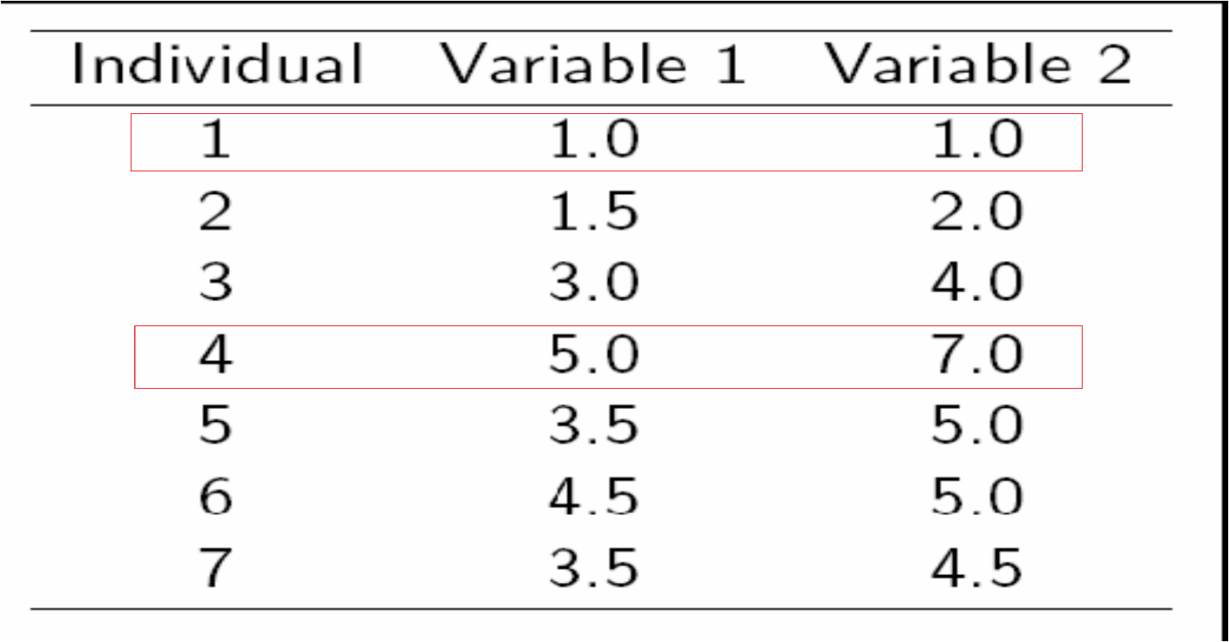

Step 1:
Initialization: Randomly we choose following two centroids
(k=2) for two clusters.
In this case the 2 centroid are: m1 = (1.0,1.0) and m2 = (5.0,7.0)

Slide 11



Step 2:
Thus, we obtain two clusters containing:
{1,2,3} and {4,5,6,7}.
Their new centroids are:
Individual | Centroid 1 | Centroid 2
1 | 0 | 7.21
2 | 1.12 | 6.10
3 | 3.61 | 3.61
4 | 7.21 | 0
5 | 4.72 | 2.5
6 | 5.31 | 2.06
7 | 4.30 | 2.92
Distance from individual points to the two centroids

Slide 12
Step 3:
Now using these centroids we compute the Euclidean distance of each object, as shown in table.
Therefore, the new clusters are:
{1,2} and {3,4,5,6,7}
Next centroids are: m1=(1.25,1.5) and m2 = (3.9,5.1)
Individual | Centroid 1 | Centroid 2
1 | 1.57 | 5.38
2 | 0.47 | 4.28
3 | 2.04 | 1.78
4 | 5.64 | 1.84
5 | 3.15 | 0.73
6 | 3.78 | 0.54
7 | 2.74 | 1.08
Distance from individual points to the two centroids

Slide 13
Step 4 :
The clusters obtained are:
{1,2} and {3,4,5,6,7}
Therefore, there is no change in the cluster.
Thus, the algorithm comes to a halt here and final result consist of 2 clusters {1,2} and {3,4,5,6,7}.
Individual | Centroid 1 | Centroid 2
1 | 0.56 | 5.02
2 | 0.56 | 3.92
3 | 3.05 | 1.42
4 | 6.66 | 2.20
5 | 4.16 | 0.41
6 | 4.78 | 0.61
7 | 3.75 | 0.72

Slide 14

PLOT

Slide 15
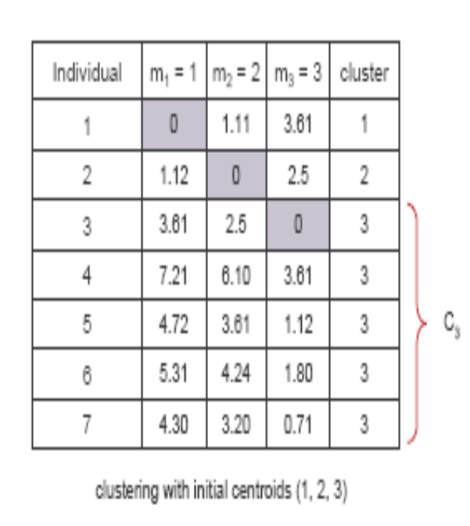
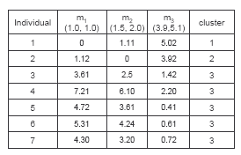
(with K=3)
Step 1
Step 2

Slide 16
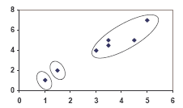
PLOT

Slide 17
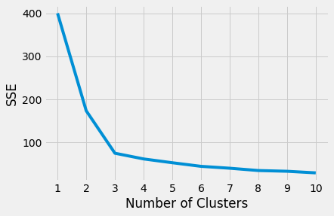
Elbow Method (choosing the number of clusters)
Elbow Method
Another Method - silhouette coefficient (self study)

Slide 18
Weaknesses of K-Mean Clustering
When the numbers of data are not so many, initial grouping will determine the cluster significantly.
The number of cluster, K, must be determined before hand. Its disadvantage is that it does not yield the same result with each run, since the resulting clusters depend on the initial random assignments.
We never know the real cluster, using the same data, because if it is inputted in a different order it may produce different cluster if the number of data is few.
It is sensitive to initial condition. Different initial condition may produce different result of cluster. The algorithm may be trapped in the local optimum.

Slide 19
Applications of K-Mean Clustering
It is relatively efficient and fast.
k-means clustering can be applied to machine learning or data mining
Used on acoustic data in speech understanding to convert waveforms into one of k categories or Image Segmentation.

Slide 20
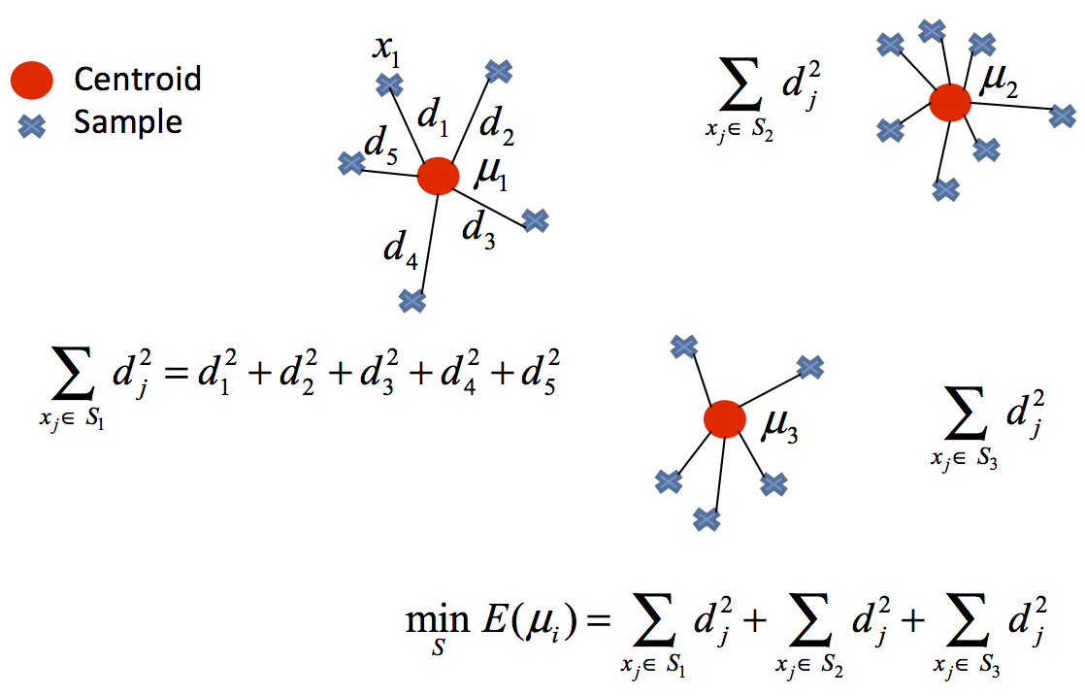
Visualization: Example

Slide 21
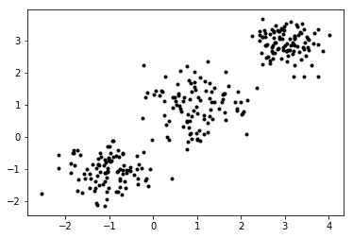
Visualization: Example

Slide 22
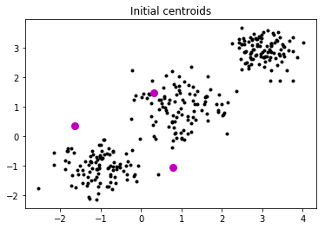
Visualization: Example

Slide 23
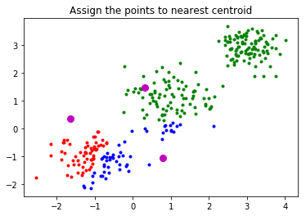
Visualization: Example

Slide 24
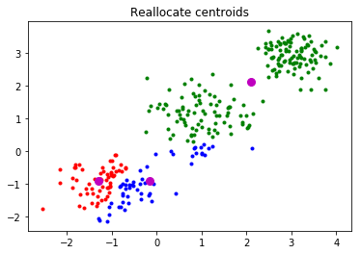
Visualization: Example

Slide 25
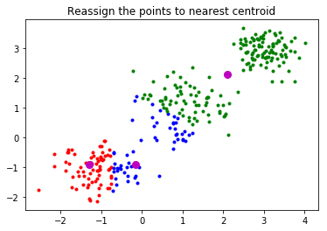
Visualization: Example

Slide 26
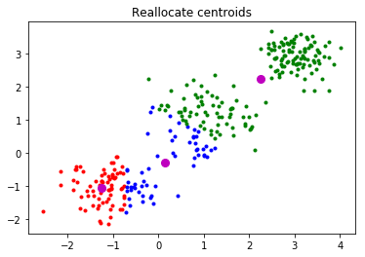
Visualization: Example

Slide 27
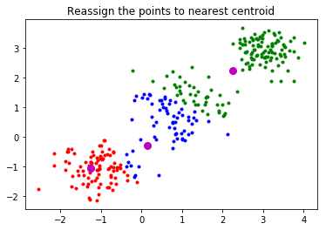
Visualization: Example

Slide 28
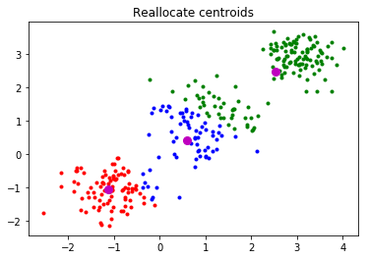
Visualization: Example

Slide 29
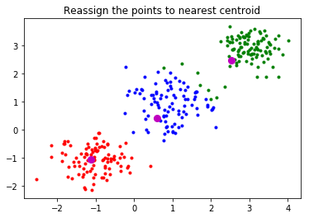
Visualization: Example

Slide 30
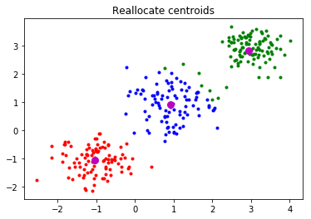
Visualization: Example

Slide 31
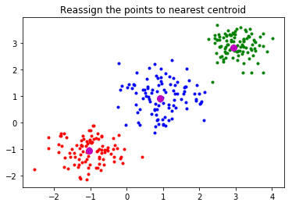
Visualization: Example

Slide 32

Visualization: Example

Slide 33

Visualization: Example

Slide 34

Visualization: Example

Slide 35
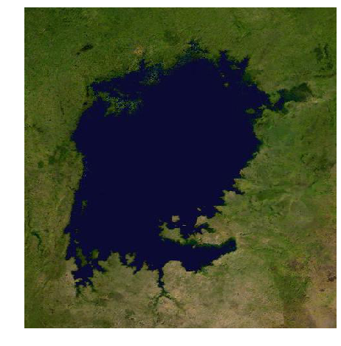
Application: Segmentation

Slide 36
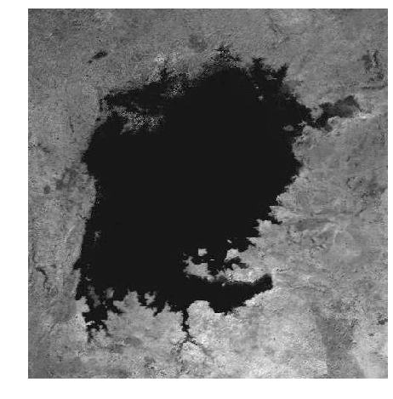

Slide 37
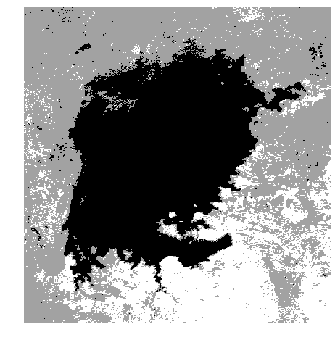
Segmentation

